Slide 1

Analyzing Factors Impacting Suicidal Behavior In American Youth

Slide 2




Data Jockeys
Ashlesha
Sampathi
Mounica
Mandapati
Nitesh
Maruthi
Venkat
Reddy

Slide 3

Outline
Background
Data
Analysis
Recommendations

Slide 4

Quote
—Sam Finch, Suicide Survivor
“Imagine a scale being tipped back and forth until one side is finally outweighed by the other — a trigger, a moment of impulsivity, a window of opportunity that disrupts the precarious balance that allowed us to survive”

Slide 5


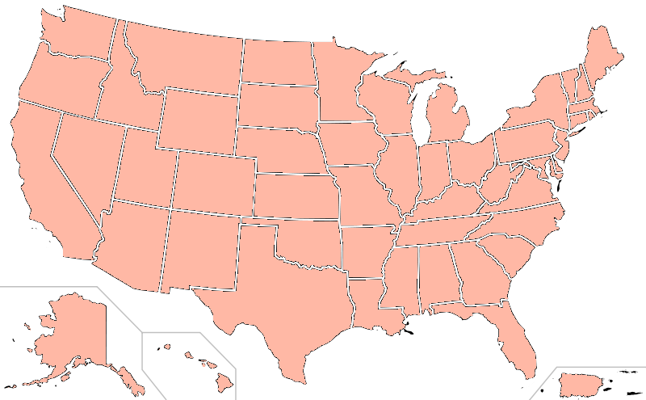



Background
Introduction
6,241 suicides
Delicate Minds
2nd Leading
Cause
(12-19)
Suicide Prevention

Slide 6


Data
Dataset
Demographics
1990 – 2017
99 questions
Drugs and Alcohol use
9th to 12th grades
180 schools
Mental issues
14,783 teens
Sexual activity

Slide 7
Data
Feature Engineering
Bullying
Abuse of
narcotics
Sexual Minorities
Suicidal
Attempts
Dichotomous Variables

Slide 8
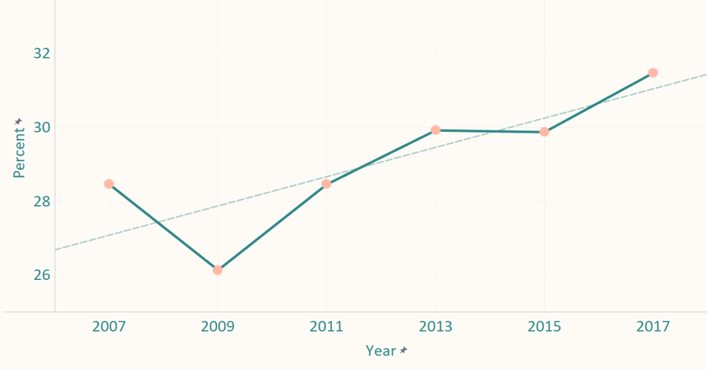
Data
Trend Analysis
Percentage of depressed teens over the past decade

Slide 9
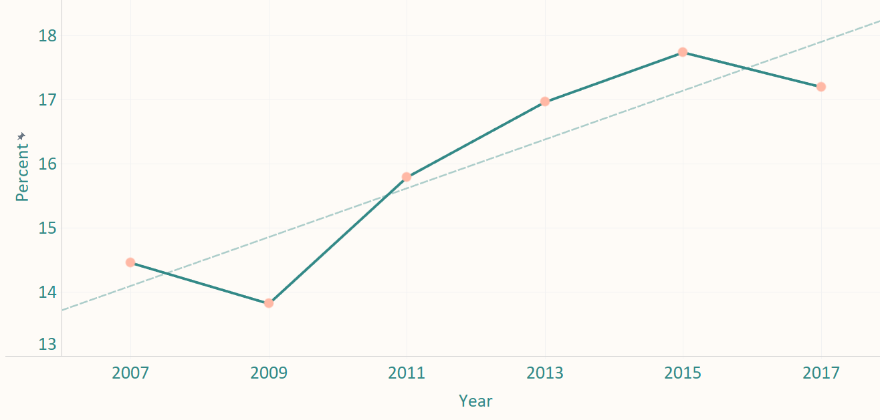
Data
Trend Analysis
Percentage of teens who seriously considered suicide over the past decade

Slide 10
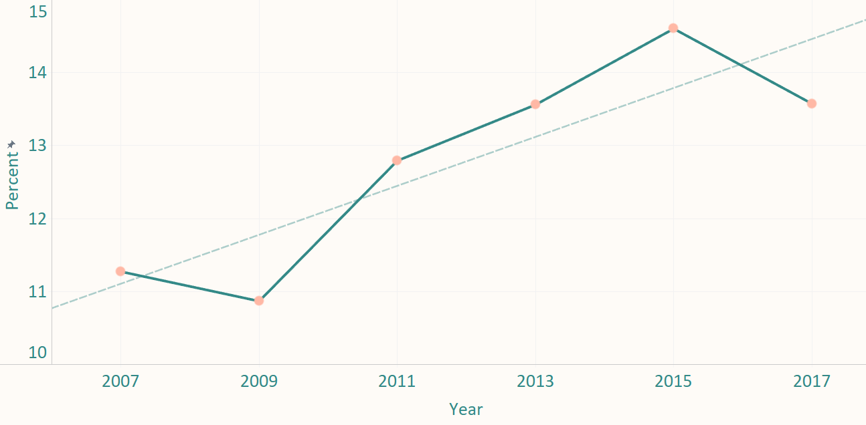
Data
Trend Analysis
Percentage of teens who planned suicide over the past decade

Slide 11
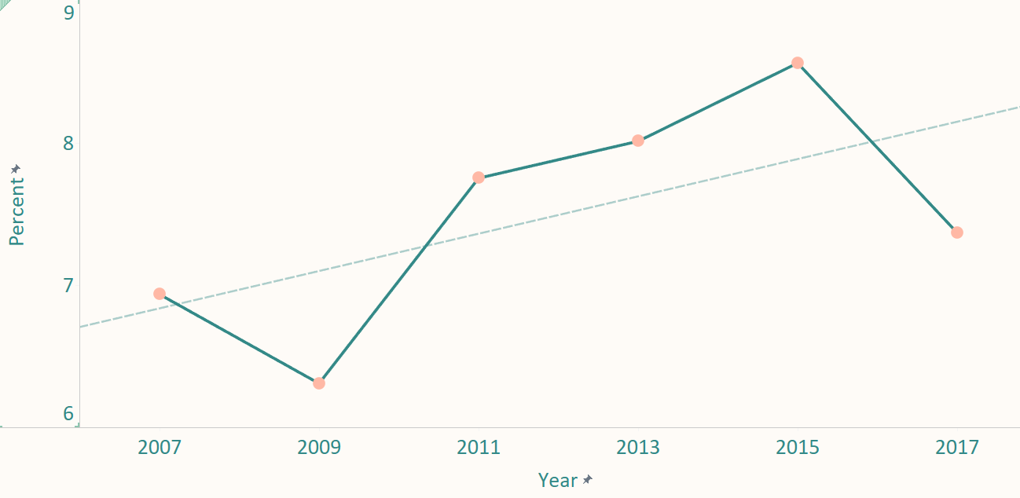
Data
Trend Analysis
Percentage of teens who attempted suicide over the past decade

Slide 12
Data
Funnel of Despair
Depression
6,241
teens
committed
suicide
Suicidal thoughts
45%
Planned suicide
29%
Attempted
Suicide
16%

Slide 13
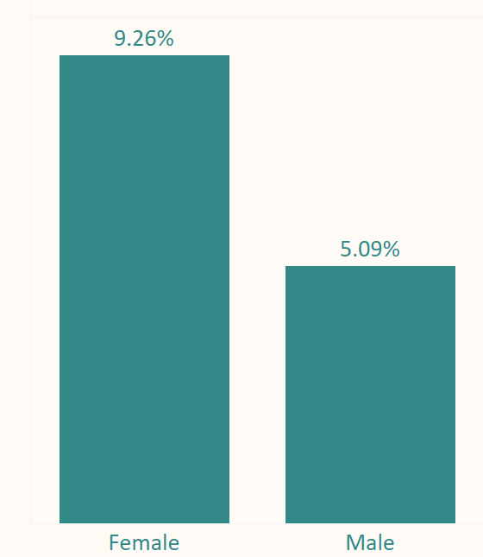
Data
Suicide Attempts by Gender

Slide 14
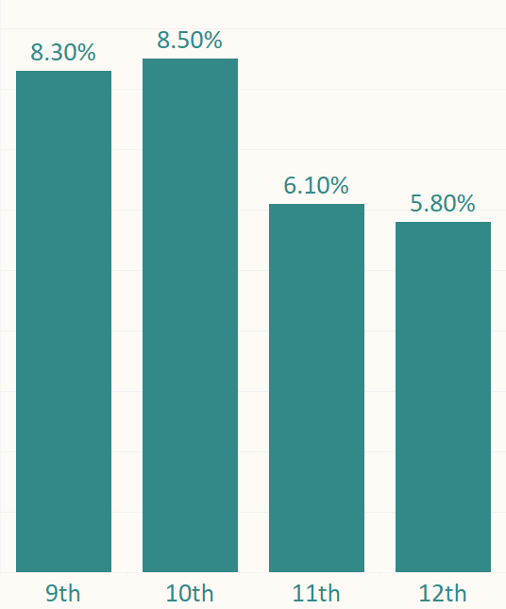
Data
Suicide Attempts by Grade

Slide 15
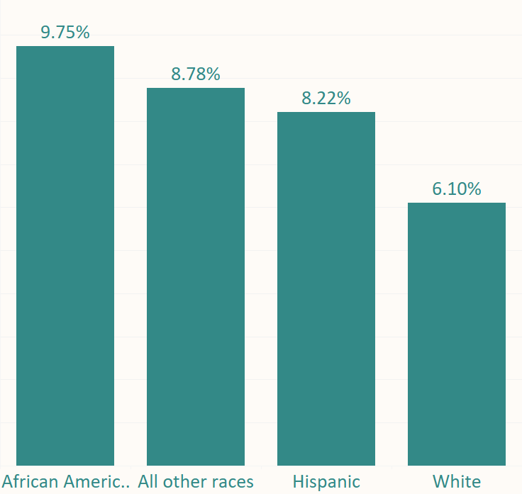
Data
Suicide Attempts by Race

Slide 16

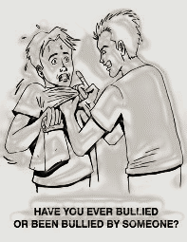
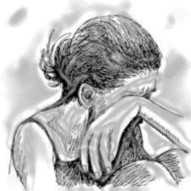
Analysis
Latent Class Analysis
Rape Victims
Bullied Victims
Depressed Victims
Sexually Assaulted
Bullied
Depressed
Bullied
Depressed
Depressed

Slide 17
Analysis
Cause-Effect
Drug Abuse
Sexual Minorities
Physical Fights
Bullying at School
Sexual Assault
Obesity
Depression
Suicide Attempts

Slide 18

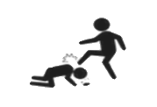
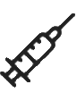


Analysis
Quantifying Causes
Odds Ratio from surveylogistic:
Depressed teens 8 times more likely to attempt Suicide
Sexual Assault
Bullying
4.7 x
Drug Abuse
3.6 x
Sexual Minorities
3.5 x
Obesity
2.3 x
1.4 x

Slide 19
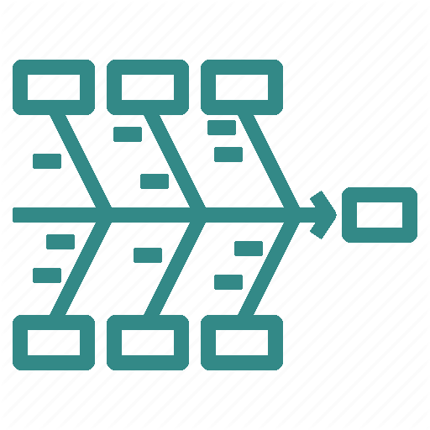
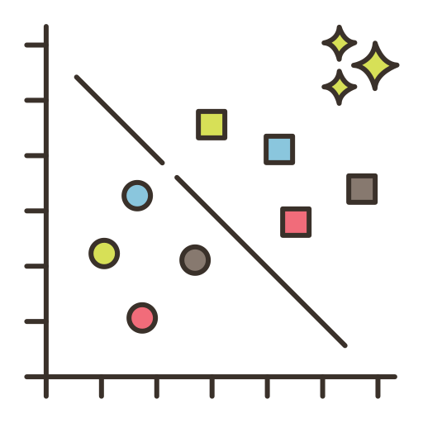

Conclusion
Summary
Regression
Latent
Classes
Cause/
Effect

Slide 20





Recommendations
Recommendations

Slide 21



Recommendations
Future Scope
Socio-economic Data
Social Acceptance Data
Negative Social Media

Slide 22
Quote
—W. Edwards Deming
“It is not enough to do your best; you must know what to do, and then do your best.”

Slide 23

Thank You

Slide 24
Appendix
Appendix

Slide 25
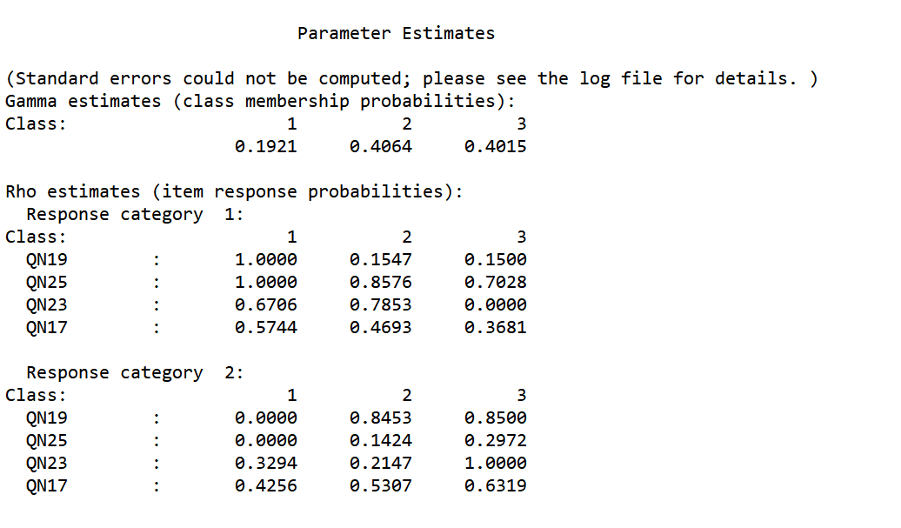
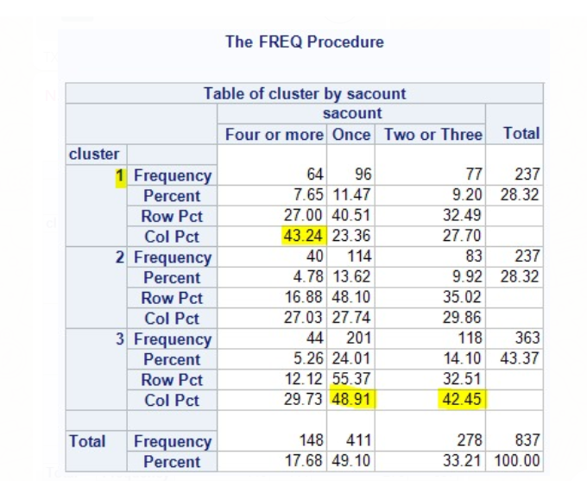
Appendix

Slide 26
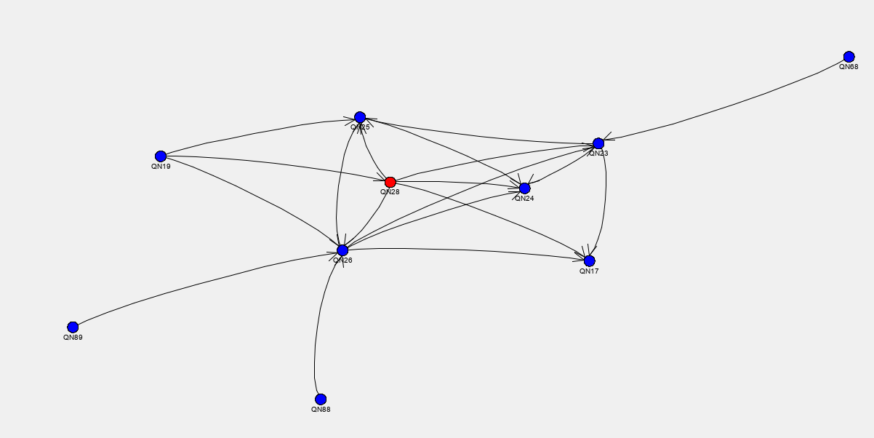
Appendix
HP Classifier

Slide 27
Appendix
Academic troubles
Sleep
Drug Abuse
Sexual Minorities
Physical Fights
Bullying at School
Sexual Assault
Obesity
Depression
Suicide Attempts
Notes:
From our lit review we found that not all variables were important in driving teens to suicide. To establish a cause effect relationship between SA and its factors, we used PC algorithm (HP classifer). We removed confounding variables that were not directly related to our target, SA.

Slide 28
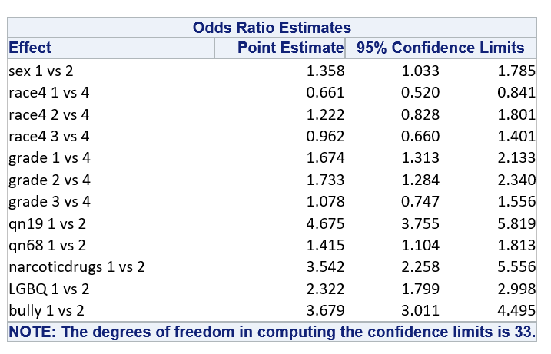
Appendix
Survey Logistic Regression
Notes:
Animation for depression likelihood, goes away
Controlling for grade, sex and race, several logistic regression models were built using survey logistic procedure. In all the initial models, we found that the presence of depression in the youth was a major factor in driving them to suicide. On average, it was found that depressed teens were 7x as likely to attempt suicide.
Talk about individual variable importance

